Slide 1

Review Analysis
Google Play App Store:

Slide 2
Contents
Question Analysis
1
Future Work
2
Thank Yous
3
Visuals and data driven analysis of each question
A high level overview of next step and recommendations
Gratitude & Memes

Slide 3
Question 1:
Which app category, in your opinion, has the best ratings? How are you measuring best ratings?

Slide 4
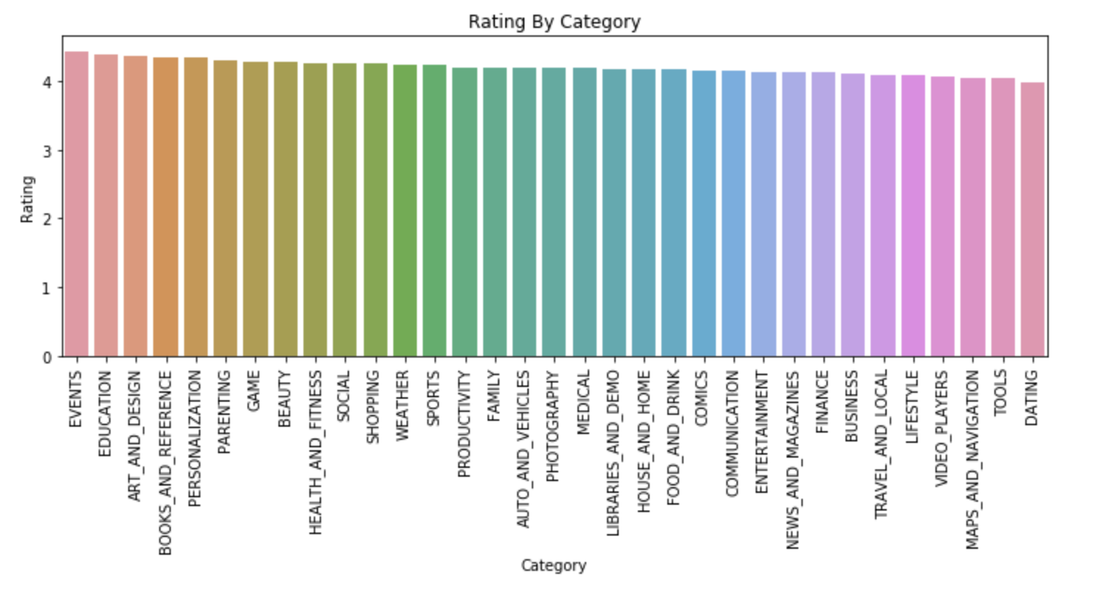
Average Rating in Each Category

Slide 5
Top 5 Game Categories by Rating Average
 | Rating
Beauty | 4.268293
Parenting | 4.27111
Art & Design | 4.314894
Education | 4.322000
Events | 4.418605

Slide 6
Events
Has the best ratings as measured by rating average per category

Slide 7
Question 2:
Is there a relationship between ratings and size? How did you measure the relationship? Why did you choose this measurement?

Slide 8
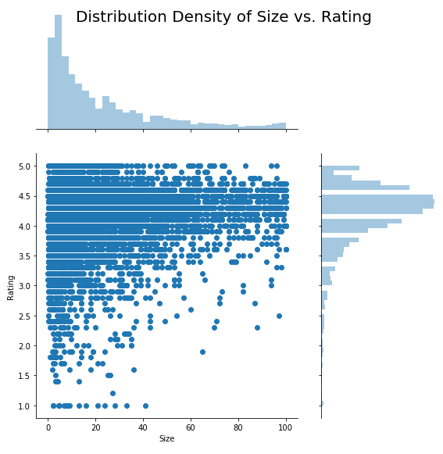
NO CORRELATION IDENTIFIED Correlation coeff. ~0.082 leading to the conclusion that there in statistically significant correlation between these two metrics
SIZE & RATING WITH DISTRIBUTION
In general this furthers our conclusion that apps tend to have a high rating & less than 20 MB in size.
‹#›

Slide 9
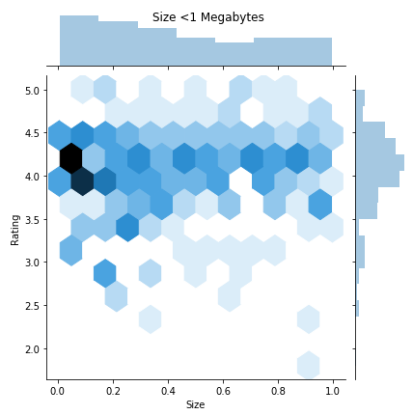
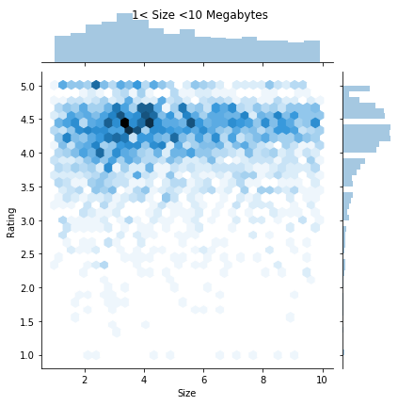
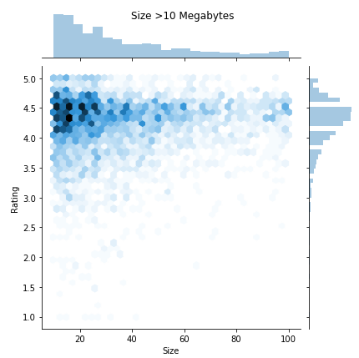
Elongated View of Size vs Ratings Relationship

Slide 10
Question 3:
For your category, how many genres are represented? What are their counts?

Slide 11
Apps Per Educational Genre
 | Value Count
General Education | 107
Creativity | 3
Music & Video | 1
Action & Adventure | 1
Pretend Play | 4
Brain Games | 3

Slide 12
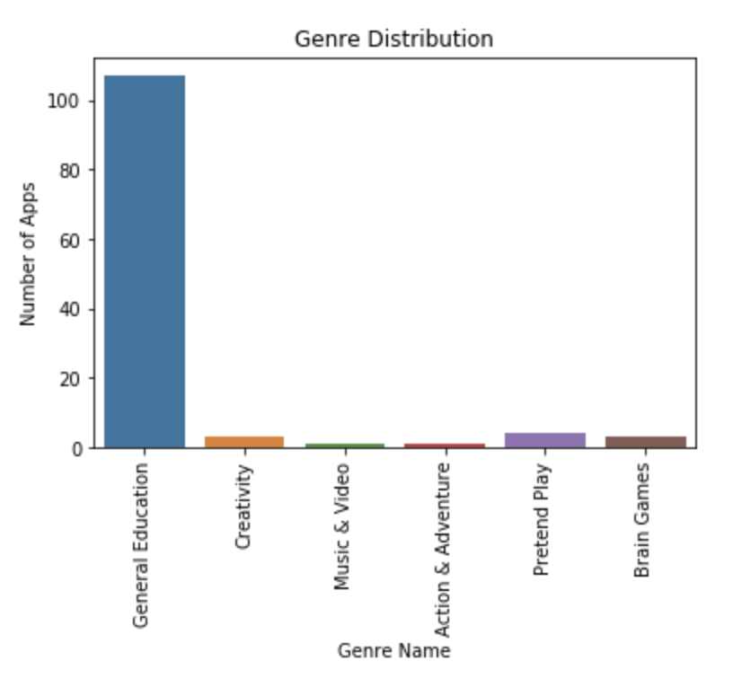
Breakdown of Educational Category by Sub Genres
MERCURY
ACTION POINT
Mercury is the closest planet to the Sun and the smallest one in the Solar System—it’s only a bit larger than our Moon. The planet’s name has nothing to do with the liquid metal since it was named after the Roman messenger god, Mercury
Developer should subgenre within the “Education” genre to further differentiate their product

Slide 13
Question 4:
How does sentiment affect our data?

Slide 14
Calculating Polarity and Subjectivity
SENTIMENT
POLARITY
SUBJECTIVE
A function of textblob that returns two properties: polarity and subjectivity
A float which lies in the range of [-1, 1] where 1 means positive statement and -1 means a negative statement
A float which lies in the range of [0,1] Personal opinion, emotion or judgment whereas objective refers to factual information.

Slide 15
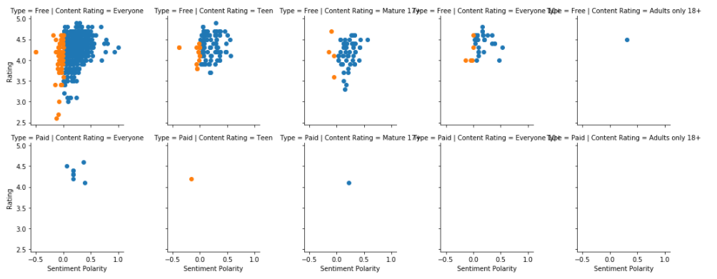
User Review EDA: Type of Content (Free/Paid) v Rating

Slide 16
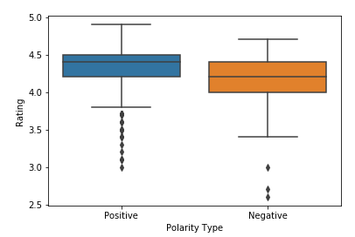
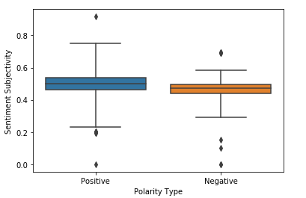
Breakdown of Positive and Negative Review Effects
Ratings based on Polarity Type
Sentiment based on Polarity Type

Slide 17
Based on initial analysis a positive review leads to a higher app rating.
However, negative sentiment is not closely linked to negative reviews.

Slide 18
Future Work:
Extend Analysis Recommendations
SIZE
Breaking down size category into feature lists to dig deeper into the size, rating correlation
PRICE Data modeling of price and rating correlation with pricing implications
SENTIMENTALITY The effect of high sentimentality on likelihood of writing app reviews
CATEGORY Hypothetical modeling of category type on download rate

Slide 19
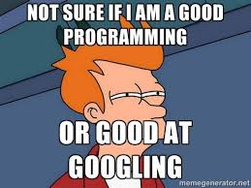
Thanks!
Does anyone have any questions?

